Slide 1



Driver Drowsiness Detection System
ERODE SENGUTHAR ENGINEERING COLLEGE
( An Autonomous Institution)
Perundurai, Erode – 638 057.
Department Of Computer Science And Engineering
Guided by
Ms. S. Sivaselvi,AP/CSE
Presented by
DHARANI R [ES19CS13]
KAVENESH N [ES19CS36]
NANDHAKUMAR S [ES19CS44]

Slide 2
ABSTRACT
Drowsiness detection is a safety technology that can prevent accidents that are caused by drivers who fell asleep while driving.
The main aim is to build a drowsiness detection system which alerts the driver whenever he/she feels drowsy
The eye movement of the driver is monitored live and whenever the driver feels asleep or closes eye for more than few seconds , It alerts the driver with the help of alarm sound

Slide 3
OBJECTIVES
This system can be used to reduce the amount of road accidents that happens to great extent.
The main motive of this system is that it can save a lot of lives.

Slide 4
INTRODUCTION
Traffic accidents due to human errors cause many deaths and injuries around the world. The major cause of these accidents is drowsiness of the driver due to sleeplessness or long driving hours.
To prevent such accidents, our team has come up with a solution for this. In this system, a camera is used to record user's visual characteristics.
We use face detection and CNN techniques and try to detect the drowsiness of driver, if he/she is drowsy then alarm will be generated. So that the driver will get cautious and take preventive measures.
Driver drowsiness detection contributes to the decrease in the number of deaths occurring in traffic accident.

Slide 5
EXISTING SYSTEM
The existing system used Support Vector Machine (SVM) for classifying the face (if the eyes ae closed or not) as drowsy or not drowsy.
To separate the two classes of data points, there are many possible hyperplanes that could be chosen.
The objective of SVM is to find a plane that has the maximum margin, i.e., the maximum distance between data points of both classes.

Slide 6
DISADVANTAGE OF EXISTING SYSTEM
SVM does not perform very well when the data set has more noise i. e target classes are overlapping.
It requires more time to process

Slide 7
PROPOSED SYSTEM
In this system, instead of Support Vector Machine (SVM) we use a Classification Model based on Convolutional Neural Networks (CNN).
Deep Learning is concerned with algorithms inspired by the structure and function of the brain called artificial neural networks.
Convolutional Neural Networks are a type of Artificial Neural Networks which are widely used for image classification and even Multi-Class classification of images.
Convolution layers in a CNN consist of a set of learnable filters.
We propose CNN since the accuracy of the system is improved by using a CNN. The driver’s face is continuously captured using a camera. The image frames are extracted and by face detection, the face of the driver is detected.
A classification model is built based on CNN to classify the face as drowsy / not drowsy.

Slide 8
ADVANTAGE OF PROPOSED SYSTEM
This CNN base system provide High Accuracy.
It is Easy of use.
It Works well in low lighting condition.

Slide 9
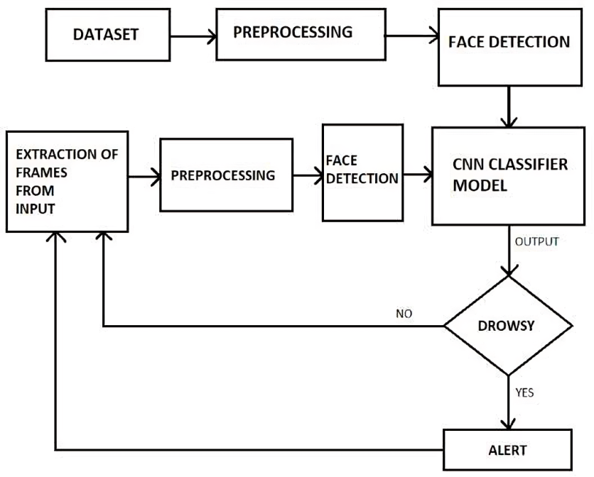
SYSTEM ARCHITECTURE

Slide 10
MODULES LIST
Collecting the Dataset
Face Detection
Eye Detection
Classification

Slide 11
COLLECTING THE DATASET
The data comprises around 1435 images of people’s eyes under different lighting conditions.
We separated them into their respective labels ‘Open’ or ‘Closed’.
This dataset also includes images with the people wearing spectacles.

Slide 12
FACE DETECTION
This module takes input from the camera and tries to detect a face in the video input.
The detection of the face is achieved through the Haar classifiers mainly, the Frontal face cascade classifier.
The face is detected in a rectangle format and converted to grayscale image and stored in the memory which can be used for training the model.

Slide 13
EYE DETECTION
This model works on building a detection system for drowsiness we need to focus on the eyes to detect drowsiness.
The eyes are detected through the video input by implementing a haar classifier namely Haar Cascade Eye Classifier.
The eyes are detected in rectangular formats.

Slide 14
CLASSIFICATION
We continuously capture image frames from the camera.
The same preprocessing steps which are applied on the dataset are applied on each frame captured i.e., detecting the face from the image frame, extract the Region of Interest and then resizing the Region of Interest to a fixed size (100x100).
Then we convert the images into array format to give input to the model.
Then, we should give a set of images to the trained CNN Classification model to predict the labels for the images.
If the driver is feeling drowsy, a voice alert is generated. An audio file is played using the playsound module in python.

Slide 15
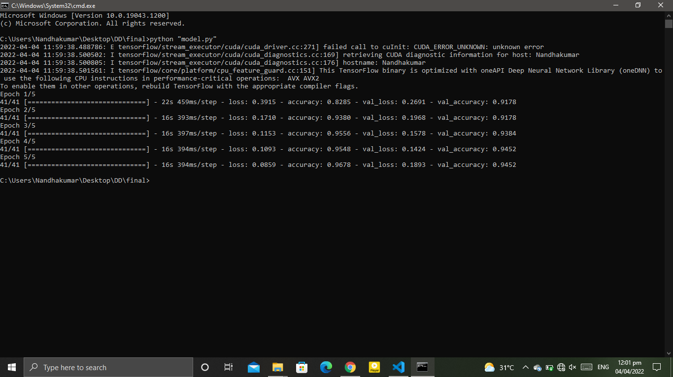
SAMPLE OUTPUT
Fig 1. Model Build and Epoch Generated

Slide 16
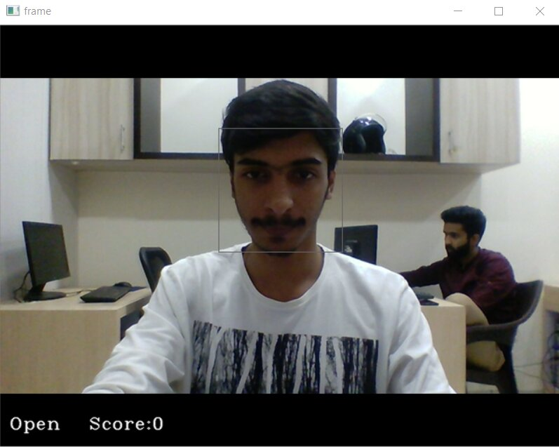
SAMPLE OUTPUT
Fig 2. Open eyes

Slide 17
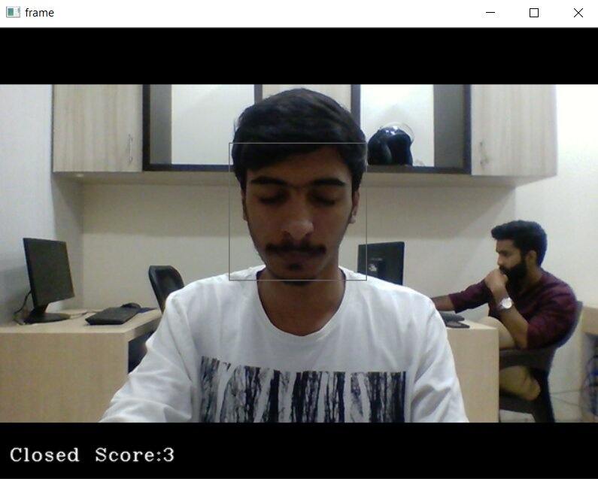
SAMPLE OUTPUT
Fig 3. Close eyes

Slide 18
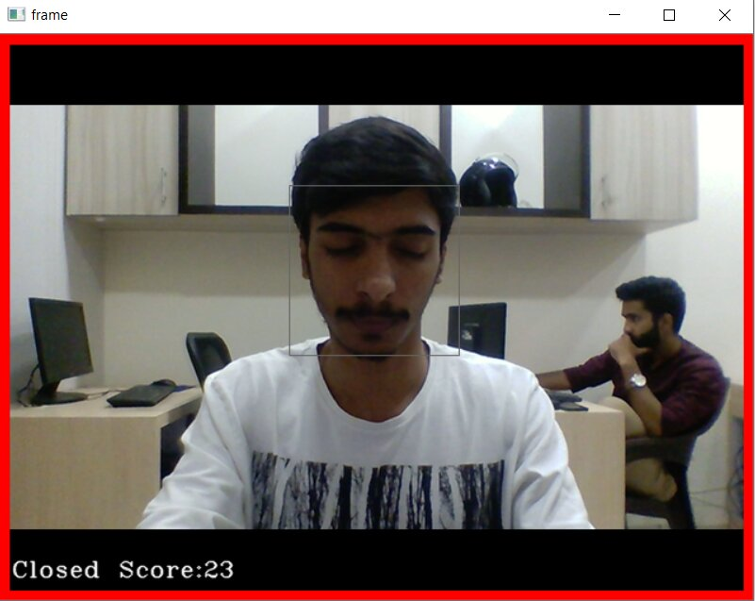
SAMPLE OUTPUT
Fig 4. Sleep Alert

Slide 19
REFERENCES
[1] Kaushish, V., Singh, N., Maggo, K., Nagrath, P., & Jain, R. (2021). Driver drowsiness detection system with opencv and keras. SSRN Electronic Journalpp. 1- 11. https://ssrn.com/abstract=3884784
[2] Yang, J.H., Mao, Z.H., Tijerina, L., Pilutti, T., Coughlin, J.F., Feron, E. (2009). Detection of driver fatigue caused by sleep deprivation. IEEE Transactions on Systems, Man, and Cybernetics - Part A: Systems and Humans, 39(4): 694-705. https://doi.org/10.1109/tsmca.2009.2018634
[3] Hu, S., Zheng, G. (2009). Driver drowsiness detection with eyelid related parameters by support vector machine. Expert Systems with Applications, 36(4): 7651-7658. https://doi.org/10.1016/j.eswa.2008.09.030
[4] Mardi, Z., Ashtiani, S.N., Mikaili, M. (2011). EEG-based drowsiness detection for safe driving using chaotic features and statistical tests. Journal of Medical Signals And Sensors, 1(2): 130-137. https://doi.org/10.4103/2228-7477.95297
[5] Noori, S.M., Mikaeili, M. (2016). Driving drowsiness detection using fusion of electroencephalography, electrooculography, and driving quality signals. J Med Signals Sens, 6: 39-46. https://doi.org/10.4103/2228-7477.175868

Slide 20
THANK YOU

